Slide 1










Chinook Music Store
By:
Syeda Saima Nasreen

Slide 2




About Chinook Music Store
Chinook Music Service in East Wenatchee, WA, established in 1995, is a premier, full-service music store providing instrument sales, rentals, and repairs for North Central Washington.

Slide 3




Problem Statement
You are hired as a data analyst at Chinook, and your objective is to analyze music record sales data to gain insights and make recommendations for the company's strategy in the physical music market.

Slide 4

Data Dictionary
customer
invoice
customer_id: Unique identifier assigned to each customer.
first_name: The given name or first name of a customer.
last_name: The surname or family name of a customer.
company: The name of the company associated with a customer.
address: The street address of a customer's location.
city: The city where a customer is located.
state: The state or province where a customer is located.
country: The country where a customer is located.
postal_code: The postal or zip code of a customer's address.
phone: The phone number of a customer.
fax: The fax number associated with a customer.
email: The email address of a customer.
support_rep_id: The employee ID of the support representative assigned to a customer.
invoice_id: Unique identifier assigned to each invoice.
customer_id: The customer ID associated with the invoice.
invoice_date: The date when the invoice was generated or issued.
billing_address: The street address used for billing purposes.
billing_city: The city used for billing purposes.
billing_state: The state or province used for billing purposes.
billing_country: The country used for billing purposes.
billing_postal_code: The postal or zip code used for billing purposes.
total: The total amount due on the invoice.

Slide 5
Data Dictionary
invoice_line
playlist_track
playlist_id: The ID of the playlist to which the track belongs.
track_id: The ID of the track included in the playlist.
track
track_id: Unique identifier assigned to each track or song.
name: The title or name of the track.
album_id: The ID of the album to which the track belongs.
media_type_id: The ID of the media type associated with the track.
genre_id: The ID of the genre associated with the track.
composer: The name of the composer or artist who composed the track.
milliseconds: The duration of the track in milliseconds.
bytes: The file size of the track in bytes.
unit_price: The price per unit for the track.
invoice_line_id: Unique identifier assigned to each line item on an invoice.
invoice_id: The invoice ID to which the line item belongs.
track_id: The ID of the track or product included in the line item.
unit_price: The price per unit for the line item.
quantity: The quantity of units for the line item.
playlist
playlist_id: Unique identifier assigned to each playlist.
name: The name or title of the playlist.

Slide 6
Data Dictionary
album
media_type
media_type_id: Unique identifier assigned to each media type.
name: The name or description of the media type (e.g., MPEG audio file, AAC audio file).
Genres
genre_id: Unique identifier assigned to each genre.
name: The name or description of the genre (e.g., rock, pop, classical).
album_id: Unique identifier assigned to each album.
title: The title or name of the album.
artist_id: The ID of the artist associated with the album.
artist
artist_id: Unique identifier assigned to each artist.
name: The name of the artist.

Slide 7

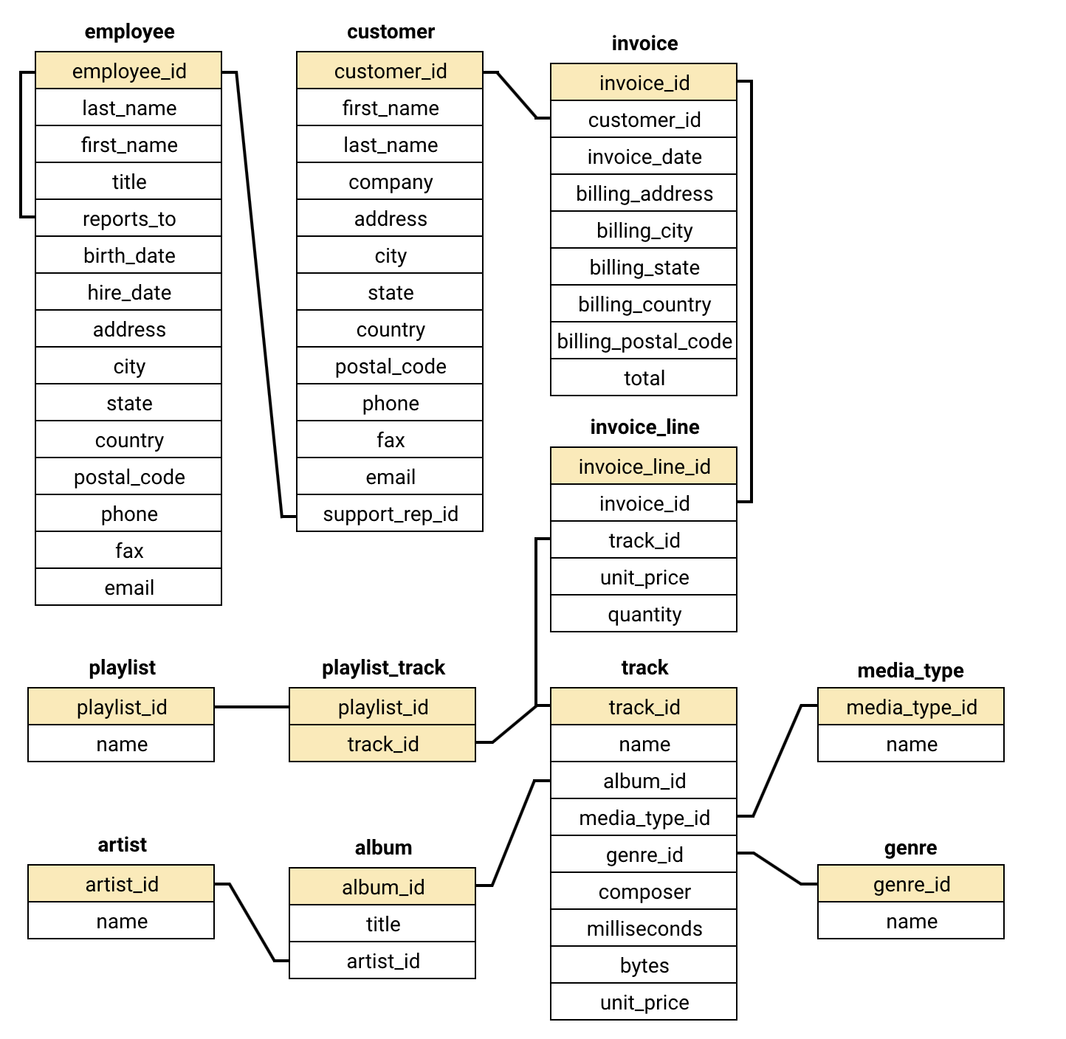
Database Schema

Slide 8
Description of analytical methods and tools used
SQL Queries: Used to extract, filter, and analyze customer purchases, sales trends, and revenue insights from the Chinook database.
Descriptive Statistics : Measured total sales, average order value, and purchase frequency.
Data Visualization (Excel) : Created charts for sales trends, top customers, and genre performance.
Customer Segmentation: Compared long-term vs. new customer behavior.
Trend Analysis: Identified seasonal sales patterns and high-demand genres.
Revenue Analysis: Found top revenue-generating customers and best-selling tracks.

Slide 9

Top Genres by Sales
Rock is the most popular genre in the USA based on top tracks and top artist
Van Halen dominates the USA market with strong fanbase and high sales
Rock appears twice in the top 5 tracks, proving its popularity
Rock-based genres make up 4 of 5 top tracks (Rock, Metal, Alternative)
Market is diverse - R&B/Soul also present, showing varied listener preferences

Slide 10

Customers by Country
USA is the primary market - 13 customers (22.03% of total)
Canada is second-largest - 8 customers (13.56% of total)
Brazil and France tie - 5 customers each (8.47% each) as key secondary markets
Top 5 countries account for 59% of all customers (USA, Canada, Brazil, France, Germany)
Age and gender data not available - only location-based demographics possible

Slide 11

Total Revenue by Country
Prague leads globally - highest revenue ($273.24) and most invoices (30)
USA has widest spread - 12+ cities generating revenue, led by Mountain View ($169.29)
London ($166.32) and Berlin ($158.40) - top European markets after Prague
São Paulo leads Brazil - $129.69 in revenue from 22 invoices
India shows emerging potential - Delhi ($111.87) and Bangalore ($71.28) vs Australia's minimal presence ($81.18)

Slide 12

Genre Sales % in USA
Rock dominates with 53.38% - more than all other genres combined
Top 3 genres (Rock, Alternative & Punk, Metal) - account for 77.55% of total sales
Sharp drop after #3 - R&B/Soul falls to just 5.04%
14 genres have less than 5% market share - including Pop at only 2.09%
Possible data issue - Metal (11.80%) and Heavy Metal (0.29%) listed separately

Slide 13

Total Sales by Artist
Van Halen is #1 - highest sales at 42.57, leading by ~5 points over #2
Tight competition among top 5 - all within 9 points of each other (33.66 to 42.57)
90s rock dominates - Nirvana, Foo Fighters, and R.E.M. hold 3 of top 5 spots
Classic rock legends - Van Halen and Rolling Stones represent 70s-80s era
100% rock in top 5 - confirms rock's dominance with no non-rock artists

Slide 14

Genre Sales Performance in the USA
Rock ranks #1 - $555.39 in sales, dominating the USA market
Alternative & Punk ($128.70) and Metal ($122.76) - rank 2nd and 3rd
Top 3 genres account for ~85% - of total USA sales
Pop and Latin tied at #7 - $21.78 each
TV Shows ranks last - only $0.99 in sales
Genre classification overlap - Alternative vs Alternative & Punk, Metal vs Heavy Metal

Slide 15

Top 3 Albums by Sales
Rock is top in 22 of 23 countries - global dominance outside USA
Canada leads Rock sales - $329.67, nearly double France ($208.89)
Argentina is the only exception - Alternative & Punk ranks #1 ($16.83)
India shows strong Rock preference - $100.98 as top genre
Australia has lower Rock sales - $33.66 compared to other Western countries

Slide 16

Regional Market Analysis: Churn Rate by Country
Germany - 50% churn (2 of 4 customers churned)
France & Brazil - 40% churn (2 of 5 customers churned)
USA - 15.38% churn (lowest among large markets, 2 of 13 churned)
Canada - 12.50% churn (1 of 8 churned)
0% churn countries - Poland, India, Portugal, Czech Republic, Ireland
Highest avg spend with 0% churn - Czech Republic ($136.62), Ireland ($114.84)
Lowest avg spend with 0% churn - Argentina ($39.60, only 1 customer)
Single-customer countries most vulnerable - 6 of 8 show 100% churn

Slide 17


Recommendations
Marketing & Promotion:
Prioritize Rock genre in USA marketing - contributes 53% of total sales
Promote top 3 albums: "Are You Experienced?", Nirvana live, "The Doors"
Launch Alternative & Punk campaigns specifically for Argentina market
Bundle Rock with Metal tracks (most purchased together - 1,622 times)
Customer Retention:
Set $100 spend or 13 purchases as VIP loyalty threshold
Target $60-$99 LTV customers (highest churn risk zone) for retention
Offer milestone rewards at 10th and 13th purchase
Implement win-back campaigns for 16 churned customers (27% churn rate)

Slide 18

Continued……
Geographic Strategy:
Focus retention on Germany (50% churn), France & Brazil (40% churn)
Study Czech Republic and Ireland (0% churn with $100+ avg spend) and replicate
Convert single-customer countries through referral programs
Expand Rock promotions in Australia and Netherlands (low sales regions)
Product & Cross-Selling:
Create "Rock & Alternative" playlists for recommendations
Recommend Green Day to Led Zeppelin fans, Foo Fighters to Green Day customers
Bundle "Are You Experienced?" with "Mezmerize" (most paired albums)
Offer "Buy 2 albums, get 1 free" on frequently paired albums

Slide 19


Conclusion
Rock dominates the USA market with 53% of sales and top artist Van Halen
Customer churn stands at 27% - 16 of 59 customers inactive in last 6 months
High-value customers never churn - those with $100+ spend or 13+ purchases have 0% churn
Top 3 albums for promotion are all classic Rock (Jimi Hendrix, Nirvana, The Doors)
Product affinity is strong - Rock paired with Metal (1,622 times) is most frequent combination
USA and Canada are primary markets with strongest customer retention
Czech Republic and Ireland show 0% churn with highest avg spend ($136 and $114)
Single-customer countries are most vulnerable to churn (6 of 8 show 100%)
Data limitations exist - no age, gender, or campaign tracking available
Recommended focus: retain medium LTV customers ($60-$99), expand Rock promotions globally, implement loyalty program at $100 spend threshold

Slide 20



